Slide 1
Member experience survey 2022
Peter Larter
Vice President, GCCUSA

Slide 2
2022 Member Survey

Slide 3
Respondent type
Our business is good
Our customers keep coming back
Profits are up in the last quarter by 3%
We increased customer retention by 4%
We’re getting our work done
We’re leaders
We finished the consolidation project
We are top leaders in the industry
across the board
We’re delivering for our customers
Last year we supported thousands of customers and
sold 60,000 units
89% were aged 45+
100% were active umpires
76% did seniors, only 24% juniors/ mix
83% were available every week

Slide 4
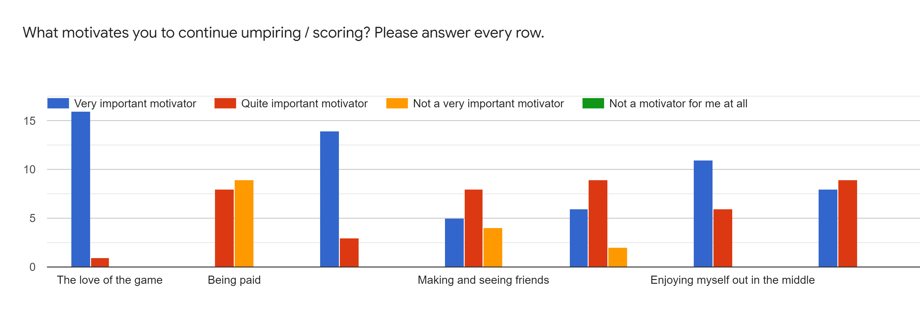
Motivation to umpire
Our business is good
Our customers keep coming back
Profits are up in the last quarter by 3%
We increased customer retention by 4%
We’re getting our work done
We’re leaders
We finished the consolidation project
We are top leaders in the industry
across the board
We’re delivering for our customers
Last year we supported thousands of customers and
sold 60,000 units

Slide 5
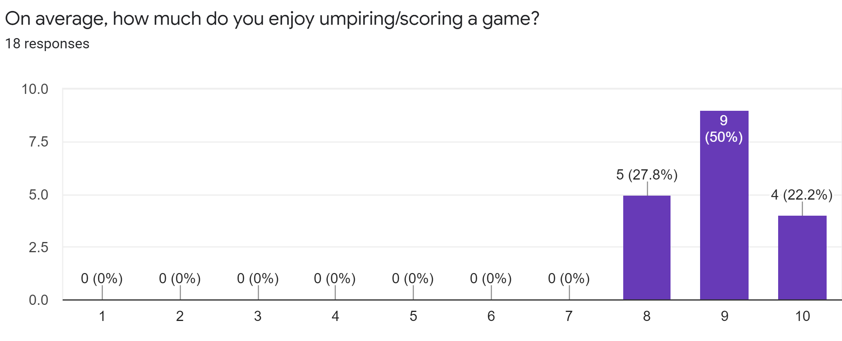
Enjoyment of umpiring
Our business is good
Our customers keep coming back
Profits are up in the last quarter by 3%
We increased customer retention by 4%
We’re getting our work done
We’re leaders
We finished the consolidation project
We are top leaders in the industry
across the board
We’re delivering for our customers
Last year we supported thousands of customers and
sold 60,000 units

Slide 6
Enjoyment of umpiring
What is the SINGLE MOST enjoyable thing about being an umpire / scorer on the Gold Coast?
Being involved in the umpire/scorer group, representing the Association, sense of purpose (5)
Meeting new people, learning about each club, interacting with players/umpires (5)
Watching the game up close, seeing games unfold, atmosphere (3)
Giving back to the game, being a small part of making cricket happen (3)
Watching juniors progress to seniors over time
Exercise (“being forced to exercise”)
The weather on the Gold Coast – play all year

Slide 7
Enjoyment of umpiring
What is the SINGLE LEAST enjoyable thing about being an umpire / scorer on the Gold Coast?
Player poor behaviour on the field by some (7) though it is improving (1)
Umpiring on your own, isolated if decision perceived to be wrong, no back up (3)
Getting a decision wrong, not hearing nicks / feather edges (2)
Players not knowing rules - silly appeals, inappropriate questioning (2)
Unprofessional behaviour off the field – negativity, gossip (1)
Skippers trying to influence you psychologically (1)
Confusing when to use yellow/red cards (1)
Stress (1)

Slide 8
How can the Association act on issues?
Reminder / training session for clubs/captains about Spirit of Cricket – us (3) or Gold Coast Cricket (1)
Ignore the white noise on the day and keep on going (1) and be trained to do this (1)
Introduce a Spirit of Cricket award for each game
Keep everyone informed of rule changes and responsibilities (which is happening)
Have a sanctions system (which we do)
Keep focus on recruiting more umpires

Slide 9
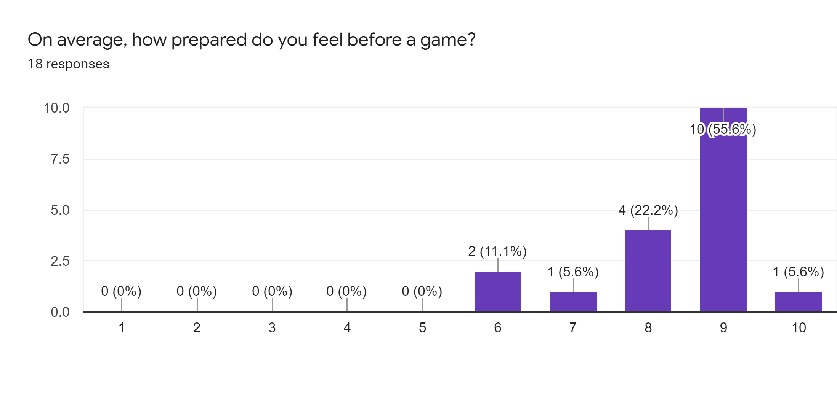
Umpire preparedness

Slide 10
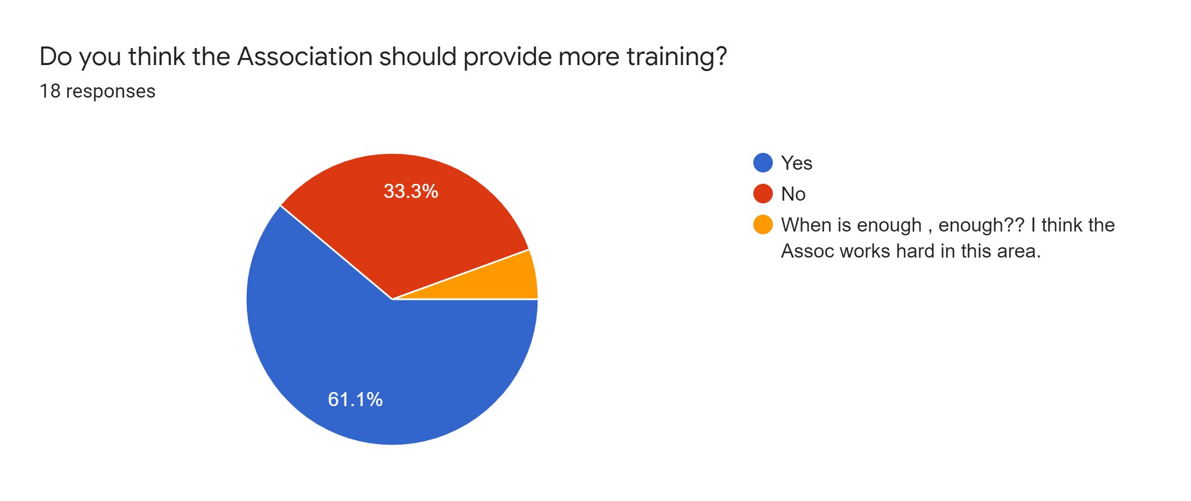
Umpire training

Slide 11
Umpire training: requested topics
Hot Topics & ‘harder things’! E.g. LBWs, penalty runs, bat-pad decisions, unusual laws, down leg side (3)
Practical training with a mentor on request or as needed (3)
Laws of Cricket and Playing Conditions (2)
On-field techniques (2)
Resilience: match management, conflict resolution
More hands on training from first class umpires
Keeping hydrated – health tips
“You can never get enough training – short and sharp”

Slide 12
How can we attract new umps/scorers?
Be more proactive with clubs to target members –Open Day; actively go to AGM, GM, seminars or net sessions; engage players; posters; hold umpire meetings at club rooms (5)
Advertising/marketing (3): front row seat; local media career option; you can do juniors; paid
Market with broader reach – Qld cricket, social media, schools, website (3), Google search opt.
Target veterans, retired and masters players (2)
Member benefits e.g. at meetings (e.g. pizza or BBQ), events, mentoring early
Pilot for club members/players to “trial umpiring” with on-field support from a member
Target younger ppl (mostly under 17s). Ensure they do square leg at own games
Have social events e.g. Indoor Cricket team
Shorter game length due to heat; better player behaviour

Slide 13
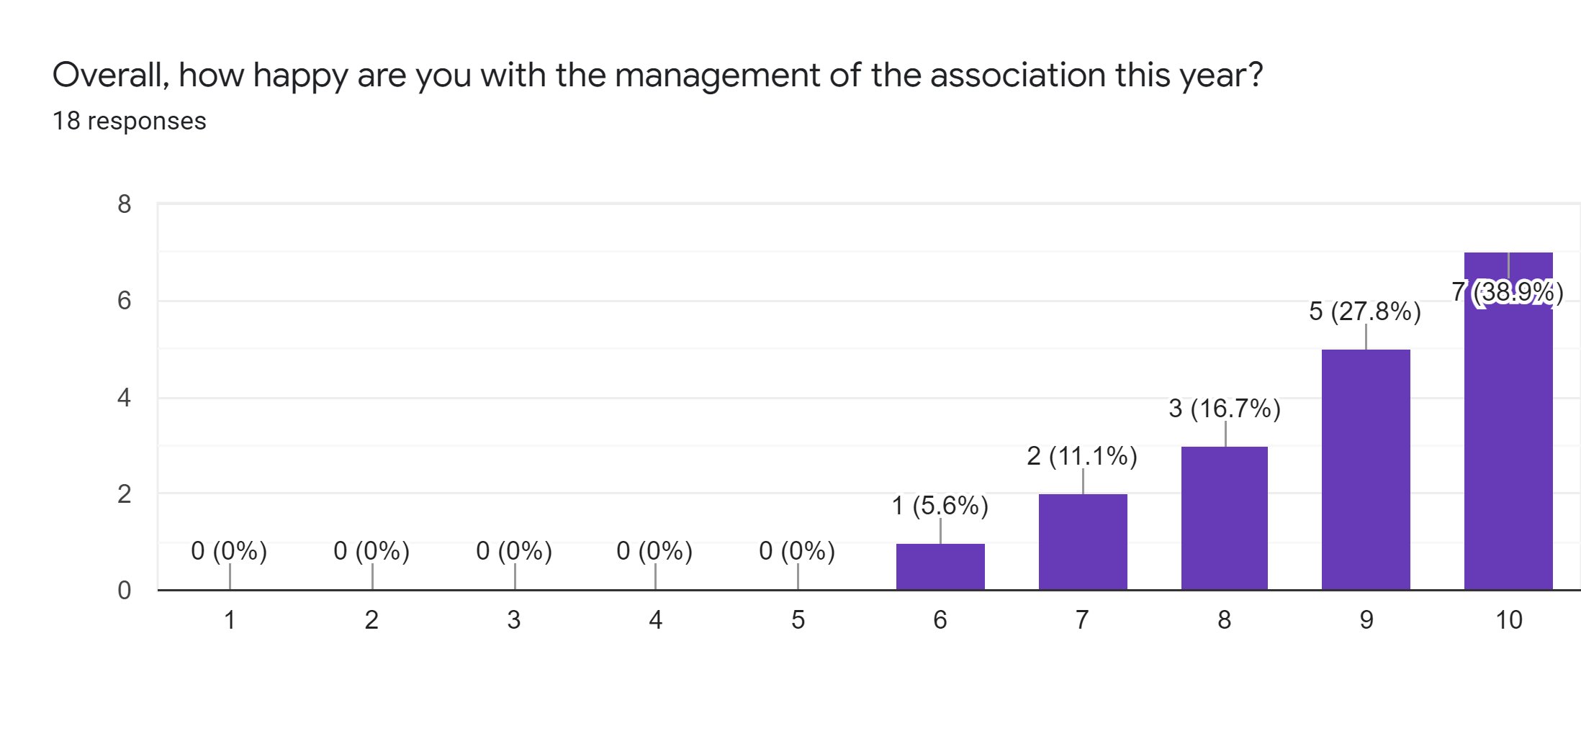
Management of the Association

Slide 14
Management of the Association
“Professional” “Seems to be very well run” “Superbly managed”
“Doing a great job with limited resources (member numbers)”
“Management works extremely hard to help the rank and file. I especially appreciate the work of the younger brigade balancing various activities”.
“Extremely great support from the committee on my Rookie year” “Extremely supportive” “Efficient and friendly”
“Appears to be a responsible , directive driven and approachable panel of experienced umpires willing to guide and aim for future improvements”
“Lots of comms, concise meetings, consistent expectations and selections, clear structure & roles for the executive”
“I am appreciating shorter meetings, i.e. less stupid questions/comments”
“I still think that there is not enough communications, reasons for being demoted etc”

Slide 15
Management of the Association
Anything else we can do to keep you as an umpire?
Playing conditions out early from GCC followed by training (2)
2 umps per game, particularly 1st grade
Work with GCC to educate players on spirit of cricket
GCC to firmly advise clubs (and then act) on inappropriate behaviour toward umpires.
Communication, leadership, care, improved conditions, support, $
No, I’m pretty self-sufficient
Website
Support for pathway progression

Slide 16
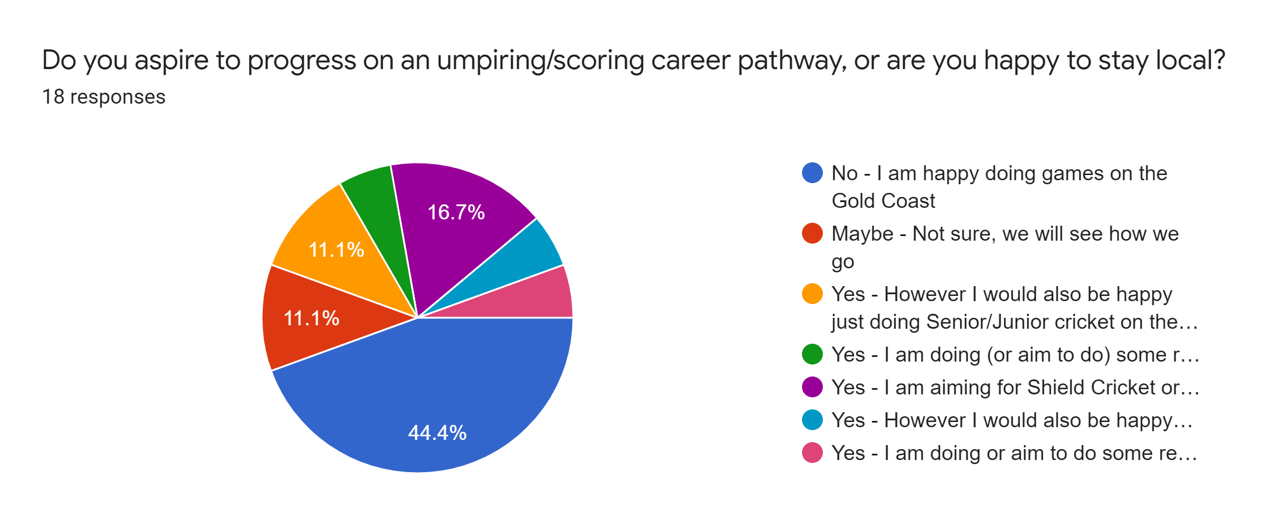
Do you aspire to ‘go higher’ in umpiring?

Slide 17
Thank you

